Slide 1
Title of the Project: Creating a Digital Repository of Medical Manuscripts of Karnataka
Sponsored by Govt. of Karnataka
To be Implemented by:
I-AIM, FRLHT, Bangalore

Slide 2
Deliverables of the Project (as per approved project proposal)
2.0 Deliverables:
2.1 Catalogue of about 15000 Medical Manuscripts
2.2 Creation of a Digital Repository of about 5000 Medical Manuscripts available in Karnataka
2.3 This Digital repository will be properly indexed
2.3 Providing search facilities to a limited extent for identifying and extracting specific information
2.3 Web-enabling the digitized information and indexes etc and making the same available in e-form

Slide 3
3.0 Steps involved in implementing the Project
3.1 Stage I Estimation of the number of medical mss in the Karnataka after identifying the institutions / personal repositories having medical Manuscripts
3.2 Stage II Development of the core and special competencies for core Team for digitizing 3.3 Stage III Digitization, Cataloguing and indexing etc.
3.4 Stage IV Testing, delivery / hosting on the Internet for enabling users to access the information etc

Slide 4
4.0 Time frame (As per approved proposal)
The proposed Timeframe for Phase 1 of the project wherein approx. 5000 medical manuscripts will be digitized, catalogued, indexed etc will be 2 years

Slide 5
Detailed work Plan
Prepare a geographically distributed and weighted list of all the institutions and private collectors who have the Manuscripts, based on the info available with NMM and other local and official resources. This involves:
- Correspondence with such institutions through phone /email / fax
etc
- Fix dates and other details for visiting such institutions / repositories
- Other related activities
Prepare a proper plan and Personally visit all the institutions / repositories for:
Survey of the existing information on the medical manuscripts available at different institutions in Karnataka, which can be classified as follows:
Manuscript libraries
Academic institutions
Ayurvedic Hospitals and Research organizations etc
Religious Institutions – Mutts, monasteries, Mosques and so on
Individual collections

Slide 6
Detailed work Plan (contd.)
After visiting each institution, fill up the questionnaire which will be as follows:
(show the questionnaire from MS Word)
Train and Engage the Digitization Team for the above purpose
(show the digitization standard PDF file prepared by NMM)
Digitize the Manuscripts at various locations
Perform other necessary tasks

Slide 7
Detailed work Plan (contd.): Software Development
This is to be carried out parallelly
Design and other aspects to be decided in few week’s time as per project proposal.
In case required, can be discussed here

Slide 8
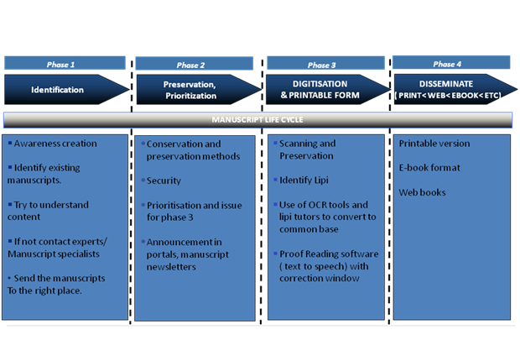
Manuscript Life cycle:

Slide 9
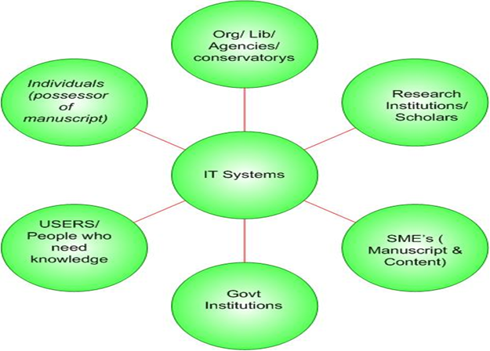
Role of IT systems

Slide 10
Technical Considerations
A digitization project includes the “basic processes - creation, storage, and management. There are components to the digitization project:
Image creation deals with the initial capture or conversion of a document or object into digital form, typically with a scanner. There may then be one or more file or image processing steps applied to the initial image, which may alter, add, or extract data. Processing will include image editing (scaling, compression, sharpening, etc.) and metadata creation.
File management refers to the organization, storage, and maintenance of images and related metadata.
Image delivery incorporates the process of getting images to the user and encompasses networks, display devices, and printers.
The tasks needed to address the above components:
Selecting items
Recording items going to digitization
Preparing items for digitization
Digitization of items
Recording digitization method and attributes (color and scale reference)
Naming image file
Saving image file
Recording image file location
Returning items to archival storage
Recording items returned
Noting image file creation

Slide 11
Digitization Project Considerations:
The technology necessary to complete the digitization consists mainly of hardware, software, and networks.
Protocols and standards, policies and procedures required for workflow, maintenance, security, upgrades, etc.
Considerations that will affect decisions about the technical infrastructure include:
Quality requirements based on document attributes
Assessing document attributes (detail, tone, color)
Defining the needs of current and future users
Objectively characterizing relevant variables (e.g., size of detail, desired quality, resolving power of system)
Correlating variables to one another via formulas
Confirming results through testing and evaluation

Slide 12
The Need and Requirements Summary
The high level requirements and scope of this project includes:
Design, Develop and Deploy an integrated web based multilingual manuscript digitisation and management system whose scope and components includes the following
Ability to categorise manuscripts. ( A standard coding and categorization system to be evolved)
Digitisation and online storage ( hardware interface tool with software )
High level summary of digitized manuscripts through manuscript data system
Creation of Search Engine – multilingual search, archiving, executive summary search, key word search and other advanced search options
Integration with existing OCR tools
A text to speech engine ( proof reading software) with a correction window
Conversion of the edited text version to e- book version
Other features that could be included in web based tool would be
Web based collaboration platform through which stakeholders can disseminate knowledge ( discussion forms, discussion about a particular manuscript, news and events about a manuscript, manuscript wiki, manuscript newsletter)
Scope Exclusions : 1) Creation of a separate OCR tool
2) All hardware necessary for the above like scanning equipment, etc

Slide 14
Project Schedule
All the tasks associated with this part of the project will be completed in a period of One year as follows:
Task | Weeks
Kickoff and Logistics | 1 and 2
Inventory, Coding | 2 to 4
Infrastructure procurement | 2 to 4
Software Setup for scanning | 4 to 8
Scanning, Indexing + level 1 validation | 9 to 25
(OCR) and proofreading tools(software) | 10 to 20
Proofreading | 14 to 40
Presentation(search Engine) + Catalog | 41 to 45
Final delivery | 45 to 52

Slide 15
Immediate action to be taken
I Step (by 15h May)
(a) Identifying Manuscript Repositories
Obtain the help from these as follows:-
Chitrakala Parishat – Intech - MAA/MAL
Write to NMM to give all details about MSS repositories in Karnataka/see their website or obtain the info (Both individual and institution) – MAA/HEMANTH, contact SP Swamy.
(3) Obtain all available details from Ramachandran and negotiate for the price. - MAA
Write to different organizations all over India and get the descriptive catalogues available or get the digitized copies - HEMANTH

Slide 16
Immediate action to be taken
II Step (by 30th May)
Based on the information available – HEMANTH
Prepare the list of places to be visited – HEMANTH
Prepare the tour plan, workout the logistics to visit. – HEMANTH/MAA/MAL
Decide about the mode of transport to visit each place – HEMANTH/MAA/MAL

Slide 17
Immediate action to be taken
III Step (June 30th)
Travel to different places, collection of information in the prepared format.
Get quotations from different digitization agencies (at least three quotations) approve the lowest fix the lowest quoting agency.
Get details about the equipments available with them – their standard – Technology – Expertise etc.
Team members – the facilities they have

Slide 18
Immediate action to be taken
IV Step (before July 31st)
Prepare detailed programme for digitization.
Obtain letter from the Government of Karnataka authorizing the team of IAIM (FRLHT) to visit various institutions, Mutts, etc and asking the Institutions to help the team to digitize Medical MSS.
IAIM should provide Identify cards to each of the members of the team (their name, status etc) with photographs.
Finalize all facilities for digitization.

Slide 19
Budget
As per explanation being given (based on project documents and realistic needs)

Slide 20
Any other issues:
To be finalized by discussion:
Staff matters
Constituting an internal committee to oversee /assess progress / provide guidelines / approve financial matters etc. & also fix Slabs for approval of bills etc. for passing of bills by Centre Head / Committee etc. and other matters to implement the project
Logistics
Equipment
Any other issues, further.

Slide 21
Thank You!

